Slide 1


Inventory Optimization
Team 23: Chloe Ramirez, Connor Flaherty, Shriya Tarun, Somil Gupta, Radha Pawar
Faculty Advisors: Robert Hammond, Daniel Mitchell

Slide 2
Agenda
01
02
03
Business Intent
Exploratory Data Analysis
Approach & Methodology
04
05
06
Answers to Business Questions
Next Steps
Conclusion
Notes:
Shriya

Slide 3

About Zebra Technologies
Leading American company in data capture & automation solutions
Specializes in barcode scanning, RFID, mobile computing, and machine vision
Enables real-time visibility across business operations
Widely used in retail, healthcare, manufacturing, and logistics
3
Notes:
Shriya

Slide 4
Problem Statement
This project provides a strategic framework for inventory optimization, analyzing stock levels and performance across Zebra's global service network.
Our goal is to answer the following:
01
02
03
What is the optimal inventory level for each spare part/location combination?
Can Zebra improve or maintain current customer satisfaction scores/material fill rate with a lower wide inventory level?
What are the key dependencies for operating under optimal inventory levels?
3
Notes:
Shriya

Slide 5


Business Value
Provides actionable recommendations for inventory optimization
Helps balance inventory cost vs. customer service levels
Aligns inventory placement with demand and lead times
Reduces excess stock while ensuring product availability
4
Notes:
shriya

Slide 6
Agenda
01
02
03
Business Intent
Exploratory Data Analysis
Approach & Methodology
04
05
06
Answer to Business Questions
Next Steps
Conclusion
Notes:
Shriya ->

Slide 7
Data Analysis – Descriptive Analysis
This analysis was based on multiple data sources and reports including On hand Report, Consumption Planning, Supplier Commit Metrics, and Inbound ASN.
Using these reports as guide, we narrowed down most of our analysis to the following tables:
Table 1
Table 2
Table 3
Table 4
4
Notes:
Chloe

Slide 8
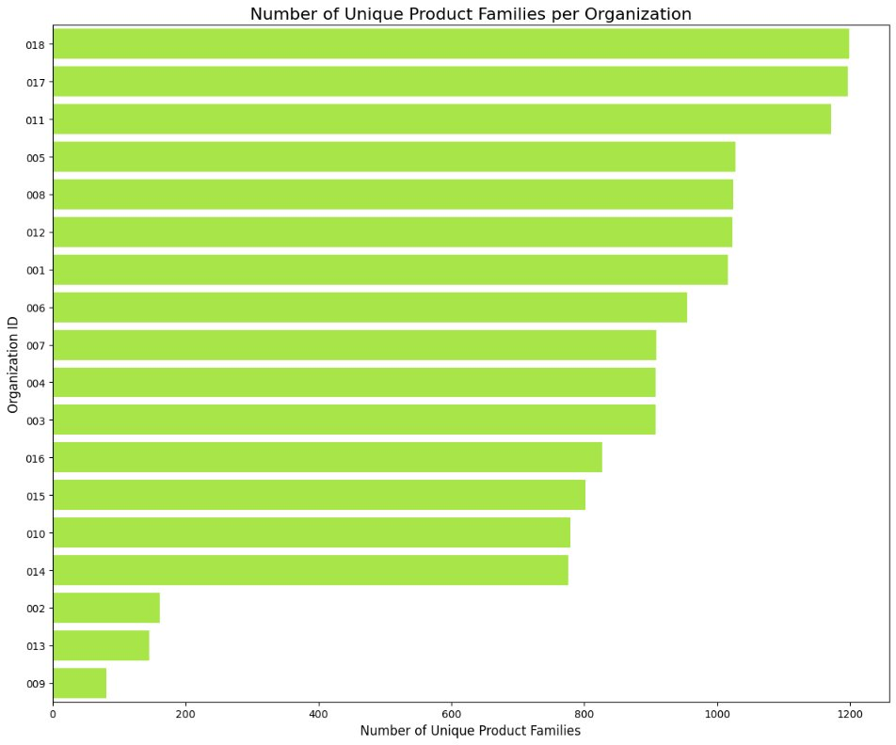
Data Analysis: Plots
Each Organization ID contained a large amount of product families
This led us to look deeper into product families as a whole
*Organization ID variables have been anonymized
4
Notes:
Chloe

Slide 9
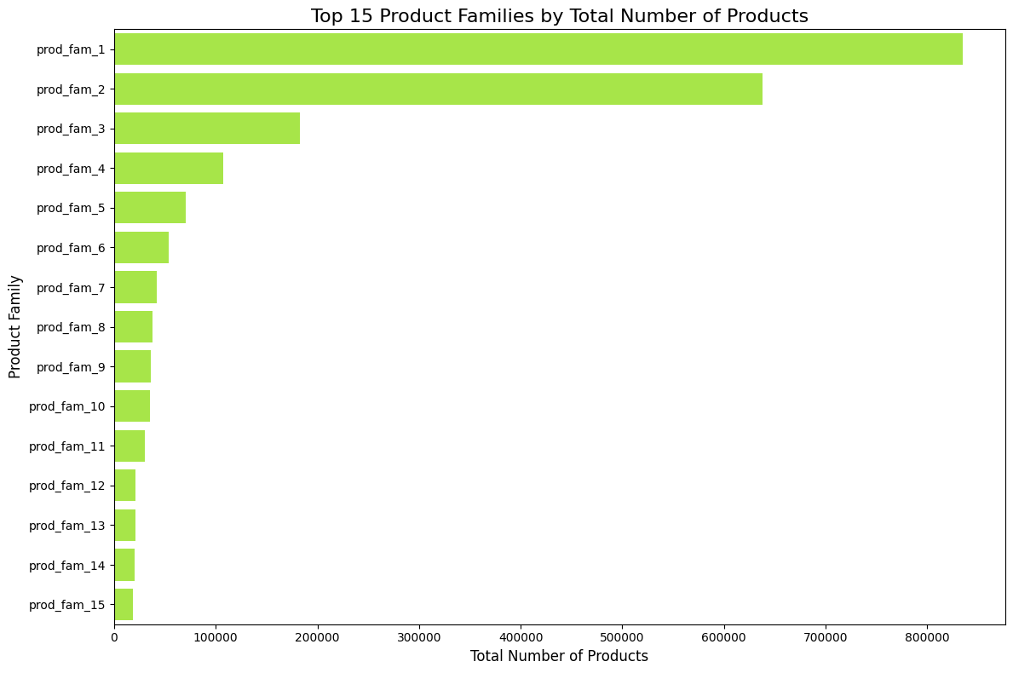
Data Analysis: Plots
Some product families carried a considerable proportion of products in inventory
Idea: produce a segmented grading system containing these product families for each organization code
*Product Family ID variables have been anonymized
4
Notes:
Chloe

Slide 10
Data Analysis: Demand Extraction & Manual Cleaning
Product Number | Product Family | Organization Code | Attribute | Date | Demand
Product A | Family 1 | 003 | Attribute 1 | 2025/03 | X
Product A | Family 1 | 003 | Attribute 1 | 2025/04 | X
Product A | Family 1 | 003 | Attribute 1 | 2025/05 | X
Product A | Family 1 | 003 | Attribute 1 | 2025/06 | X
Product A | Family 1 | 003 | Attribute 1 | 2025/07 | X
Product A | Family 1 | 003 | Attribute 1 | 2025/08 | X
Product A | Family 1 | 003 | Attribute 1 | 2025/09 | X
Product A | Family 1 | 003 | Attribute 1 | 2025/10 | X
Product A | Family 1 | 003 | Attribute 1 | 2025/11 | X
Product A | Family 1 | 003 | Attribute 1 | 2025/12 | X
Product A | Family 1 | 003 | Attribute 1 | 2026/01 | X
Product A | Family 1 | 003 | Attribute 1 | 2026/02 | X
Product A | Family 1 | 003 | Attribute 1 | 2026/03 | X
Extracted monthly demand for each spare part in each organization code
Joining issues between Table 1 and Table 2
Required manual matching and cleaning
4

Slide 11
Agenda
01
02
03
Business Intent
Exploratory Data Analysis
Approach & Methodology
04
05
06
Answer to Business Questions
Next Steps
Conclusion
Notes:
Chloe -> Connor

Slide 12
Method: Description
We used a hybrid strategy to create the most mathematically accurate model:
Linkable Installed Base → Poisson Distribution
Models "rare events"
Independent Demand History → Time-Series Fallback with weighted monthly average
Alleviates missing information
Automated Decision Gate:
If total install base is found, Poisson model is ran
If no family match: Trigger time-series fallback
Maintain a service level of 95% for a fill rate
4
Notes:
Connor

Slide 13
Model Results
We then created a Power BI dashboard to show all the predicted values for each part number for each depot
If price data found and confirmed for the specific product number, we would also reclassify the part within a A,B,C rating based on the 80,15,5 rule
Product Number | Target Level | Model Used | Location | ABC Rating
Part XYZ | X | Poisson | Location Z | A
Notes:
Connor

Slide 14
Agenda
01
02
03
Business Intent
Exploratory Data Analysis
Approach & Methodology
04
05
06
Answer to Business Questions
Next Steps
Conclusion
Notes:
Connor

Slide 15
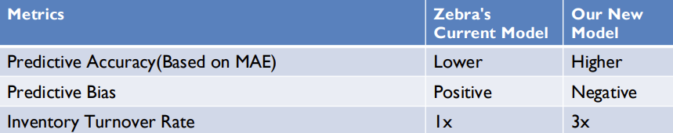
Answer to Business Question 1
The Predictions for the Month of April of Random Individual Depot X:
Higher Predictive Accuracy: Our new model has measurably lower forecast error (MAE)
A measurable reduction in overall financial risk
A significant reduction in excess inventory costs
4
Notes:
Connor

Slide 16
Answer to Business Question 2
Compared our model's predicted inventory levels per service product number/location to Zebra's actual inventory levels for the month of April.
Most locations were on-target or over-target.
Very few locations had a small percentage of parts under-target.
Evaluated customer satisfaction by comparing actual part ship dates to promised ship dates. Also evaluated lead-times per location. ​
Most locations were close to on-time (<5 days late) with two locations shipping 20+ days late.
Highly over-stocked locations performed the best on customer satisfaction and late locations were mostly on-target/partially over-stocked.
Notes:
Our second question was whether or not we could improve or maintain current customer satisfaction scores and material fill rate levels with a lower invnetory level. For this we evaluated two metrics: a volumetric fill rate (% of part orders fulfilled) and an order line fulfillment rate. Both of these performed as expected with our Poission model returning over a 95% fill rate. We also created a metric for evaluating customer satisfaction scores by looking at the date a repair shipment was promised to a customer and the actual date it was shipped to them, with a shipment on or before the promise date resulting in a hit and a late shipment resulting in a miss. From this we found that despite having an extremely high fullfillment rate they still missed on average 3 out of 4 of their promise ship dates across various evaluated months. This showed that our model required the tradeoff for a higher safety stock to improve customer satisfaction scores as they wouldn't have to backorder as many parts from their suppliers.

Slide 17
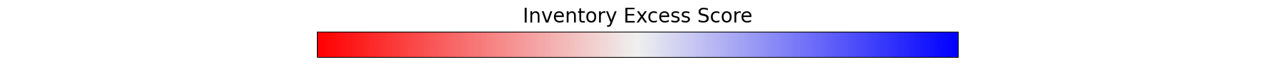
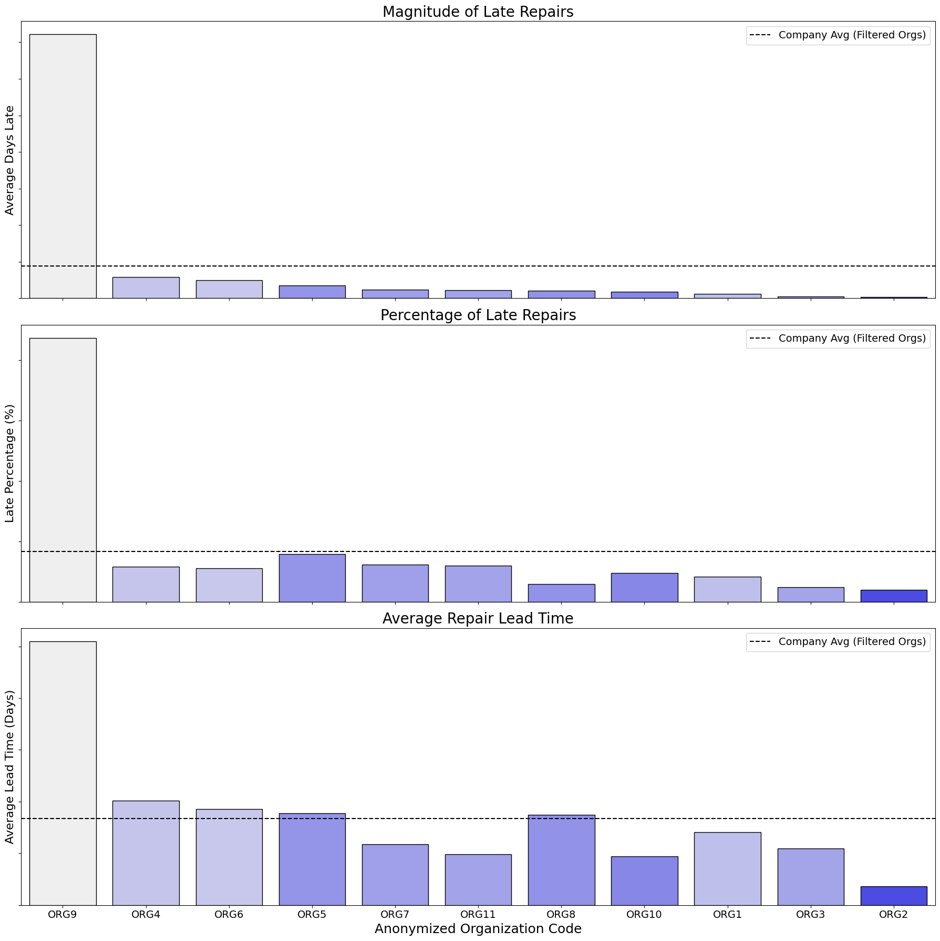
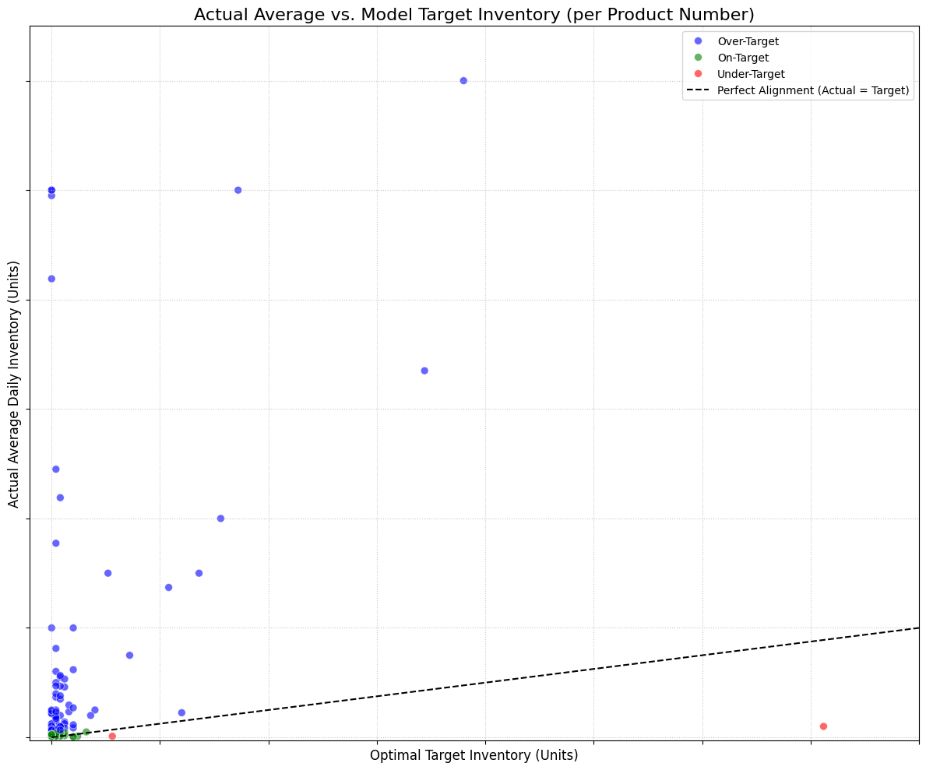
Graph to the right shows each location's performance on various customer satisfaction metrics colored by how under/over target when compared to our model
Graph below shows the magnitude of over/under stocked products
Notes:
Our second question was whether or not we could improve or maintain current customer satisfaction scores and material fill rate levels with a lower invnetory level. For this we evaluated two metrics: a volumetric fill rate (% of part orders fulfilled) and an order line fulfillment rate. Both of these performed as expected with our Poission model returning over a 95% fill rate. We also created a metric for evaluating customer satisfaction scores by looking at the date a repair shipment was promised to a customer and the actual date it was shipped to them, with a shipment on or before the promise date resulting in a hit and a late shipment resulting in a miss. From this we found that despite having an extremely high fullfillment rate they still missed on average 3 out of 4 of their promise ship dates across various evaluated months. This showed that our model required the tradeoff for a higher safety stock to improve customer satisfaction scores as they wouldn't have to backorder as many parts from their suppliers.

Slide 18
Answer to Question 3
Supplier Performance:
Unreliable supplier performance and volatile lead times are creating critical bottlenecks at primary distribution hubs
Strict SLA enforcement with underperforming suppliers is required to stabilize the network and optimize global inventory levels
Lead Time Variance:
Significant delays from key suppliers (some exceeding 80 days) create a ripple effect, forcing the holding of excess units
Notes:
Radha

Slide 19
Agenda
01
02
03
Business Intent
Exploratory Data Analysis
Approach & Methodology
04
05
06
Answer to Business Questions
Next Steps
Conclusion
Notes:
Radha

Slide 20
Next Steps:
The optimal solution going forward would be combining the systems to get the best of both worlds:
Our Poisson Distribution allowing for the reduction of excess inventory would allow for specific warehouses to run leaner margins to save costs
Their current model for the bigger warehouses that would be the major hubs for their specific regions
This would cause their customer satisfaction to continue to be excellent and save money on the inventory costs.
Would also result in less spending on items arriving too early and sitting in warehouses causing bloat.
4
Notes:
Our next steps would be exploring the possibility of combining both zebra's current methodology and our new proposed methodology. During this project we found tradeoffs between the two approaches with our model performing better in terms of stockouts but at the cost of a higher saftey stock. Their model had more accuracy with respect to hits in the forecast – likely due to their historical data being larger compared to what we could work with. This change should result in customer satisfaction rates going up, fixing supplier issues with less shipments and spending less on holding stock for too long. Finally in terms of evaluation and metrics we could utilize their payment information to extract additonal metrics that show how much cost is incurred by ordering our invnetory too early and potential cost savings or tradeoffs with various modeling decisions.

Slide 21
Agenda
01
02
03
Business Intent
Exploratory Data Analysis
Approach & Methodology
04
05
06
Answer to Business Questions
Next Steps
Conclusion
Notes:
Radha -> Somil

Slide 22
Conclusion:
We developed a model that:
Outputted a higher/safer fill rate for all service part optimal inventories for each location
Was made using Poisson distribution to maintain a minimum of 95% fill rate based on monthly consumption data.
With the new lower wide inventory level:
Month to Month our total inventory levels are lower across all Products and Locations while maintaining our 95% fill rate
Higher inventory levels are not correlated with more on-time shipments
Identified a late delivery rate on internal DC-to-Depot transfers:
Having our stock levels would mean less margin for error between DC and depot which could result these internal lead times and transfers becoming an issue if not addressed
4
Notes:
Radha

Slide 23
Thank you!

